Slide 1
Process Startup and Terminate
Lecture 08 (Part A)
[Stevens] Chap. 7

Slide 2
Outline of Chap. 7
title “Process Environment”
user-level run-time environment of a process
Lectures:
Part A: program startup and terminates
Sec. 7.1-7.4
Part B: memory layout of a process
Sec. 7.5-7.11

Slide 3
Reference
Aho, Lam, Sethi, Ullman, Compilers: Principles, Techniques, and Tools, Pearson 2007.
Chap. 7 titled “Run-Time Environments”

Slide 4
Preview on HW05
A database management program with auto recovery
Front-end Process
Back-end Process
Options:
insert data record
search data record
delete data record
list all data record
close the front-end
ListHead
name: John
ID: 1234
Deposit: 1000
name: Mary
ID: 5678
Deposit: 2000
name:Helen
ID: GG
Deposit: 3000

Slide 5
Preview on HW05
Back-end Process
always alive even the front-end is closed
store data in a linked list
Front-end Process
Back-end Process
Options:
insert data record
search data record
delete data record
list all data record
close the front-end
ListHead
name: John
ID: 1234
Deposit: 1000
name: Mary
ID: 5678
Deposit: 2000
name: Helen
ID: GG
Deposit: 3000

Slide 6
Preview on HW05
Auto-Recovery
automatic save data to disk
CTRL-C
shutdown command
no matter how the process is terminated (except for un-normal power down and kill -9)
Front-end Process
Back-end Process
Options:
insert data record
search data record
delete data record
list all data record
close the front-end
ListHead
name: John
ID: 1234
Deposit: 1000
name: Mary
ID: 5678
Deposit: 2000
name: Helen
ID: GG
Deposit: 3000

Slide 7
Preview on HW05
What you need to know
how a program is started and terminated
structure of the user-level memory space

Slide 8
Part A: How a program started and terminated
now we begin

Slide 9
All we are talking about today: Figure 7.2
user functions
exit
handler
call
exit
handler
return
call
main()
call
exit()
call
…
_exit()
return
call
standard I/O
cleanup
return
C-startup
functions
call
kernel

Slide 10
Today’s Outline
How the run-time environment is build
How a program starts up
How a program terminates

Slide 11
How the run-time environment is built

Slide 12
Process startup and terminates
user functions
exit
handler
call
exit
handler
return
call
main()
call
exit()
call
…
_exit()
return
call
standard I/O
cleanup
return
C-startup
functions
call
kernel

Slide 13
Process startup and terminates
user functions
exit
handler
call
your program starts here
exit
handler
return
call
main()
call
exit()
call
…
_exit()
return
call
standard I/O
cleanup
return
C-startup
functions
call
kernel

Slide 14
Process startup and terminates
user functions
exit
handler
call
exit
handler
return
call
main()
call
exit()
call
…
_exit()
return
call
standard I/O
cleanup
return
C-startup
functions
call
lots of things the system automatically added for you
kernel

Slide 15
The text segment in a process’ memory layout
0
text
the program code is in the text segment
a program always starts execution from address 0
the text segment is protected from writing
program code
initialized data
uninitialized data
(.bss)
heap
stack
address
command-line arg.
environment list

Slide 16
The text segment in a process’ memory layout
0
text
the program code is in the text segment
a program always starts execution from address 0
the text segment is protected from writing
initialized data
uninitialized data
(.bss)
heap
0
_init:
....
//system initialization
call _main
_main:
//the program you write
stack
address
command-line arg.
environment list
address

Slide 17
General flow of compiling a program
source code (C/C++)
compiler
basic concepts from system programming
assembly code
assembler
object code
(machine code with external label left)
linkage editor
(linker)
library
complete machine code

Slide 18
General flow of compiling a program
source code (C/C++)
compiler (gcc)
basic concepts from system programming
assembly code
assembler (as)
object code
(machine code with external label left)
library
(/usr/lib/libc.a)
(/usr/lib/crt1.o)
linkage editor
(linker) (ld)
complete machine code

Slide 19
The text segment in a process’ memory layout
0
text
the program code is in the text segment
a program always starts execution from address 0
the text segment is protected from writing
initialized data
uninitialized data
(.bss)
heap
0
_init:
....
//system initialization
call _main
_main:
//the program you write
from crt1.o
stack
address
command-line arg.
environment list
address

Slide 20
How a process starts up

Slide 21
Startup and terminating a program
user functions
exit
handler
call
exit
handler
return
call
main()
call
exit()
call
…
_exit()
return
call
standard I/O
cleanup
return
C-startup
functions
call
kernel

Slide 22
Startup and terminating a program
user functions
exit
handler
call
exit
handler
return
call
startup path
main()
call
exit()
call
…
startup code from libc.a
e.g. initial setup of malloc ()
_exit()
return
call
standard I/O
cleanup
return
C-startup
functions
call
kernel

Slide 23
Normal process termination

Slide 24
Startup and terminating a program
user functions
exit
handler
call
exit
handler
return
call
main()
call
exit()
call
…
_exit()
return
call
standard I/O
cleanup
return
C-startup
functions
call
kernel

Slide 25
Startup and terminating a program
user functions
exit
handler
call
exit
handler
return
call
main()
call
exit()
call
…
_exit()
return
call
standard I/O
cleanup
return
C-startup
functions
normal terminating path
call
kernel

Slide 26
Startup and terminating a program
user functions
exit
handler
call
system call for normal termination
exit
handler
return
call
main()
call
exit()
call
…
_exit()
return
call
standard I/O
cleanup
return
C-startup
functions
call
kernel

Slide 27
Startup and terminating a program
user functions
exit
handler
call
system call for normal termination
exit
handler
return
call
main()
call
exit()
call
…
return
call
you can call exit()
anywhere in a program
_exit()
standard I/O
cleanup
return
C-startup
functions
call
kernel

Slide 28
Startup and terminating a program
user functions
exit
handler
call
exit
handler
return
call
main()
call
exit()
call
…
_exit()
return
call
standard I/O
cleanup
return
C-startup
functions
call
do cleanup works before terminate
kernel

Slide 29
Startup and terminating a program
user functions
exit
handler
call
flush file cache
perform close () for all opened files
exit
handler
return
call
main()
call
exit()
call
…
_exit()
return
call
standard I/O
cleanup
return
C-startup
functions
call
do cleanup works before terminate
kernel

Slide 30
Startup and terminating a program
user functions
exit
handler
call
user defined cleanup work with
atexit (user_func)
exit
handler
return
call
main()
call
exit()
call
…
_exit()
return
call
standard I/O
cleanup
return
C-startup
functions
call
do cleanup works before terminate
kernel

Slide 31
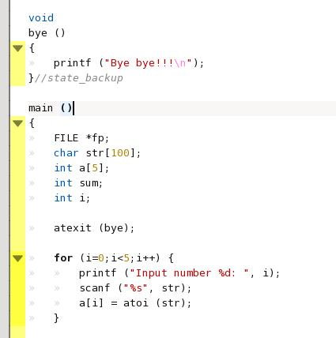
Demo: exit_string
a program saying “Bye bye!!!” at the end

Slide 32
Demo: exit_string
a program saying “Bye bye!!!” at the end
the function is to be called upon exit
registry the exit function

Slide 33
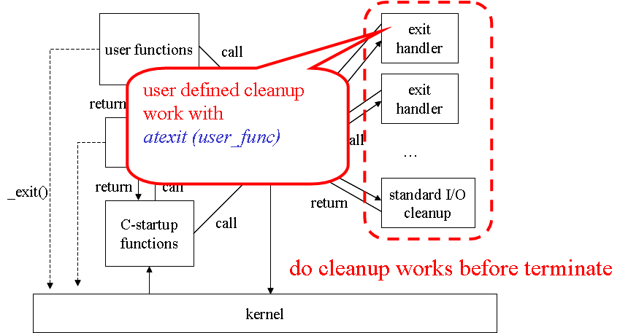
Why we need the mechanism
imagine you write a program controls lots of I/O devices

Slide 34
Abnormal process termination

Slide 35
Demo: exit_string
press CTRL-C before you input all numbers
the string “Bye bye!!!” will not be print out!

Slide 36
Startup and terminating a program
user functions
exit
handler
call
exit
handler
return
call
main()
call
exit()
system call _exit () for abnormal termination
call
…
_exit()
return
call
standard I/O
cleanup
return
C-startup
functions
call
kernel

Slide 37
When to call _exit() ?
天下大亂的時候

Slide 38
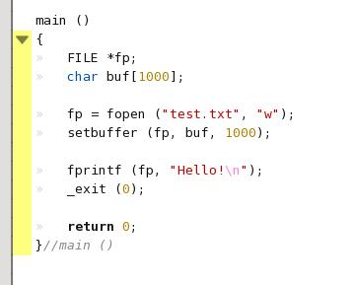
Demo: file_not_flush
The text “Hello!” will never been written to file

Slide 39
Demo: file_not_flush
The text “Hello!” will never been written to file
set a large disk cache

Slide 40
Demo: file_not_flush
The text “Hello!” will never been written to file
abnormal exit

Slide 41
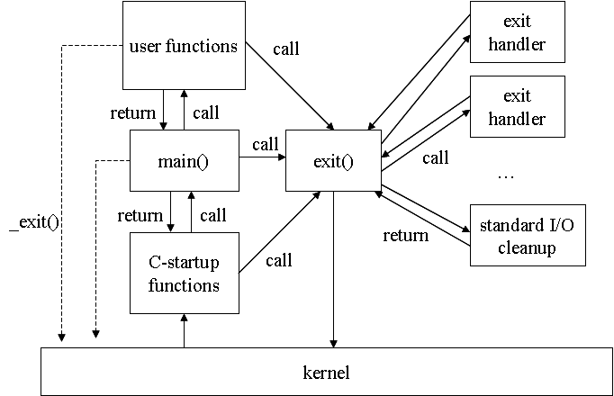
Demo: file_not_flush
The text “Hello!” will never been written to file
cleanup work will never be done due to abnormal exit

Slide 42
In-Class Exercise
怎麼殺都殺不死的蟑螂

Slide 43
In-Class Exercise
write a program that automatically save the execution status no matter how it is terminated
CTRL-C
user log-out
computer shut-down (controlled by OS)
shut-down controlled by UPS
except for kill -9

Slide 44
You need to know
setup clean-up tasks executed by exit()
force exit() to be executed for all termination condition
Remind: signal mechanism

Slide 45
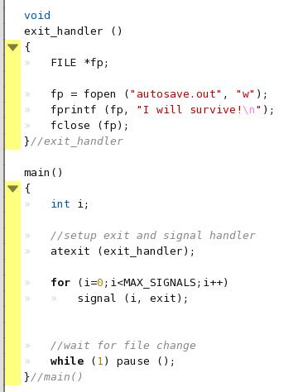
Demo: sigterm
the exit handler to save something in a file
setup the exit handler

Slide 46
Demo: sigterm
setup all signal handlers such that the normal clean-up will always been executed

Slide 47
Next Lecture
Part B: memory space layout

